Slide 1

MindBridge 🧠
Building an Inclusive World for Neurodiverse Individuals

Slide 2
Problem Statement:
Building an Inclusive World for Neurodiverse Individuals
Team No: 200
Team Name: GVPT
Problem Statement Description:
Our platform is designed to empower neurodiverse individuals by providing inclusive, AI-driven solutions for education, employment, communication, and daily life. With features like assistive technology, job-matching, and community support, we aim to create a world where neurodiversity is embraced. 🌍✨

Slide 3
Technological Stack
HTML
CSS
JS
React
API Integration

Slide 4
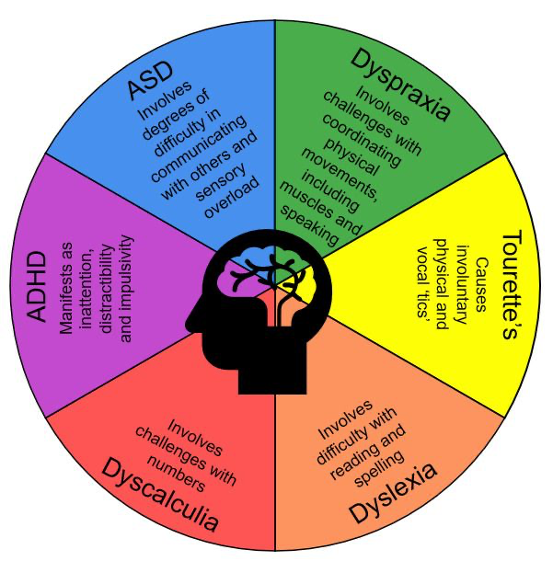
What is Neurodiversity ?
Neurodiversity is the concept that brain differences are natural variations rather than deficits. It recognizes that people experience and interact with the world in many different ways, and these differences should be respected and valued.

Slide 5
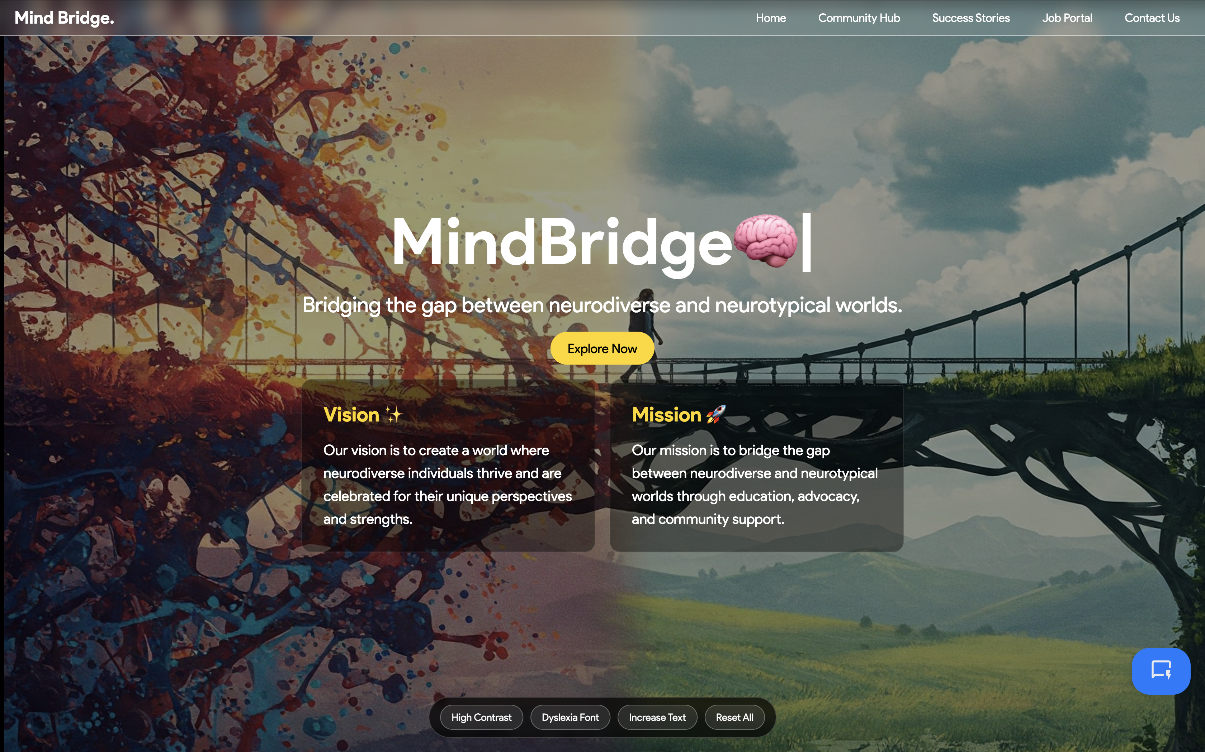
Nav bar
Explore Now
Our Vision
Our Mission
Chat
Bot
Key Accessibility Settings

Slide 6
Nav bar
Explore Now
Our Vision
Our Mission
Chat
Bot
Key Accessibility Settings
High Contrast Mode (Black background, bright text)
Helps low vision users, elderly, migraine sufferers, and outdoor users.
Dyslexia-Friendly Font (OpenDyslexic)
Aids dyslexic users, slow readers, non-native speakers, and children.
Text Size Increase
Useful for mobile users, vision-impaired individuals, and presentations.
Reset All (Quick Default Restoration)
Ideal for shared devices, accidental changes, and testing.

Slide 7
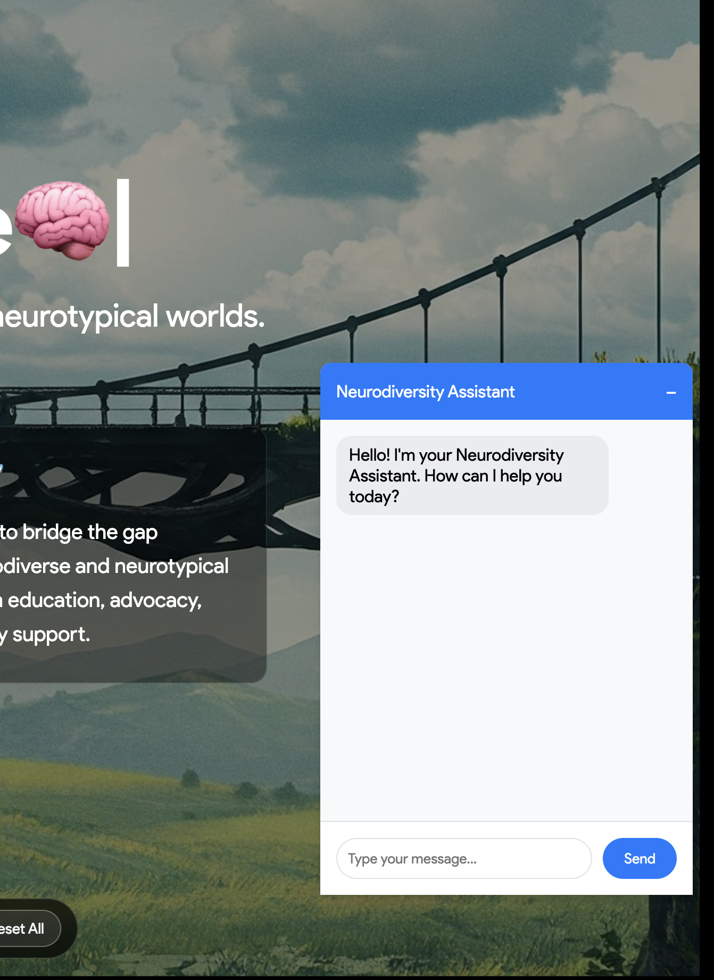
Nav bar
Explore Now
Our Vision
Our Mission
Chat Bot
Key Accessibility Settings
Instant Guidance – Provides real-time answers to neurodiversity-related questions (e.g., workplace rights, study tips).
Interview Prep** – Simulates practice interviews with ADHD/autism-friendly phrasing.
Resource Hub** – Directs users to tailored articles, job listings, or support communities.
*(Bonus: Available 24/7 without social anxiety!)* 🤖💡

Slide 8
One-Click Access – Users with ADHD can instantly jump between sections (Jobs/Community/Support) without losing focus.
Clear Hierarchy – Autistic users benefit from predictable, structured navigation with consistent labels and placement.
Emergency Exit – Anxiety-prone users can quickly return "Home" or access "Contact Help" if overwhelmed.
*(Bonus: Mobile menu avoids sensory overload with minimal icons/text.)* 🧠✨
Why it matters: The navbar isn’t just links—it’s a stress-free compass tailored to diverse cognitive needs.
Nav bar
Explore Now
Our Vision
Our Mission
Chat Bot
Key Accessibility Settings

Slide 9
Home Page

Slide 10
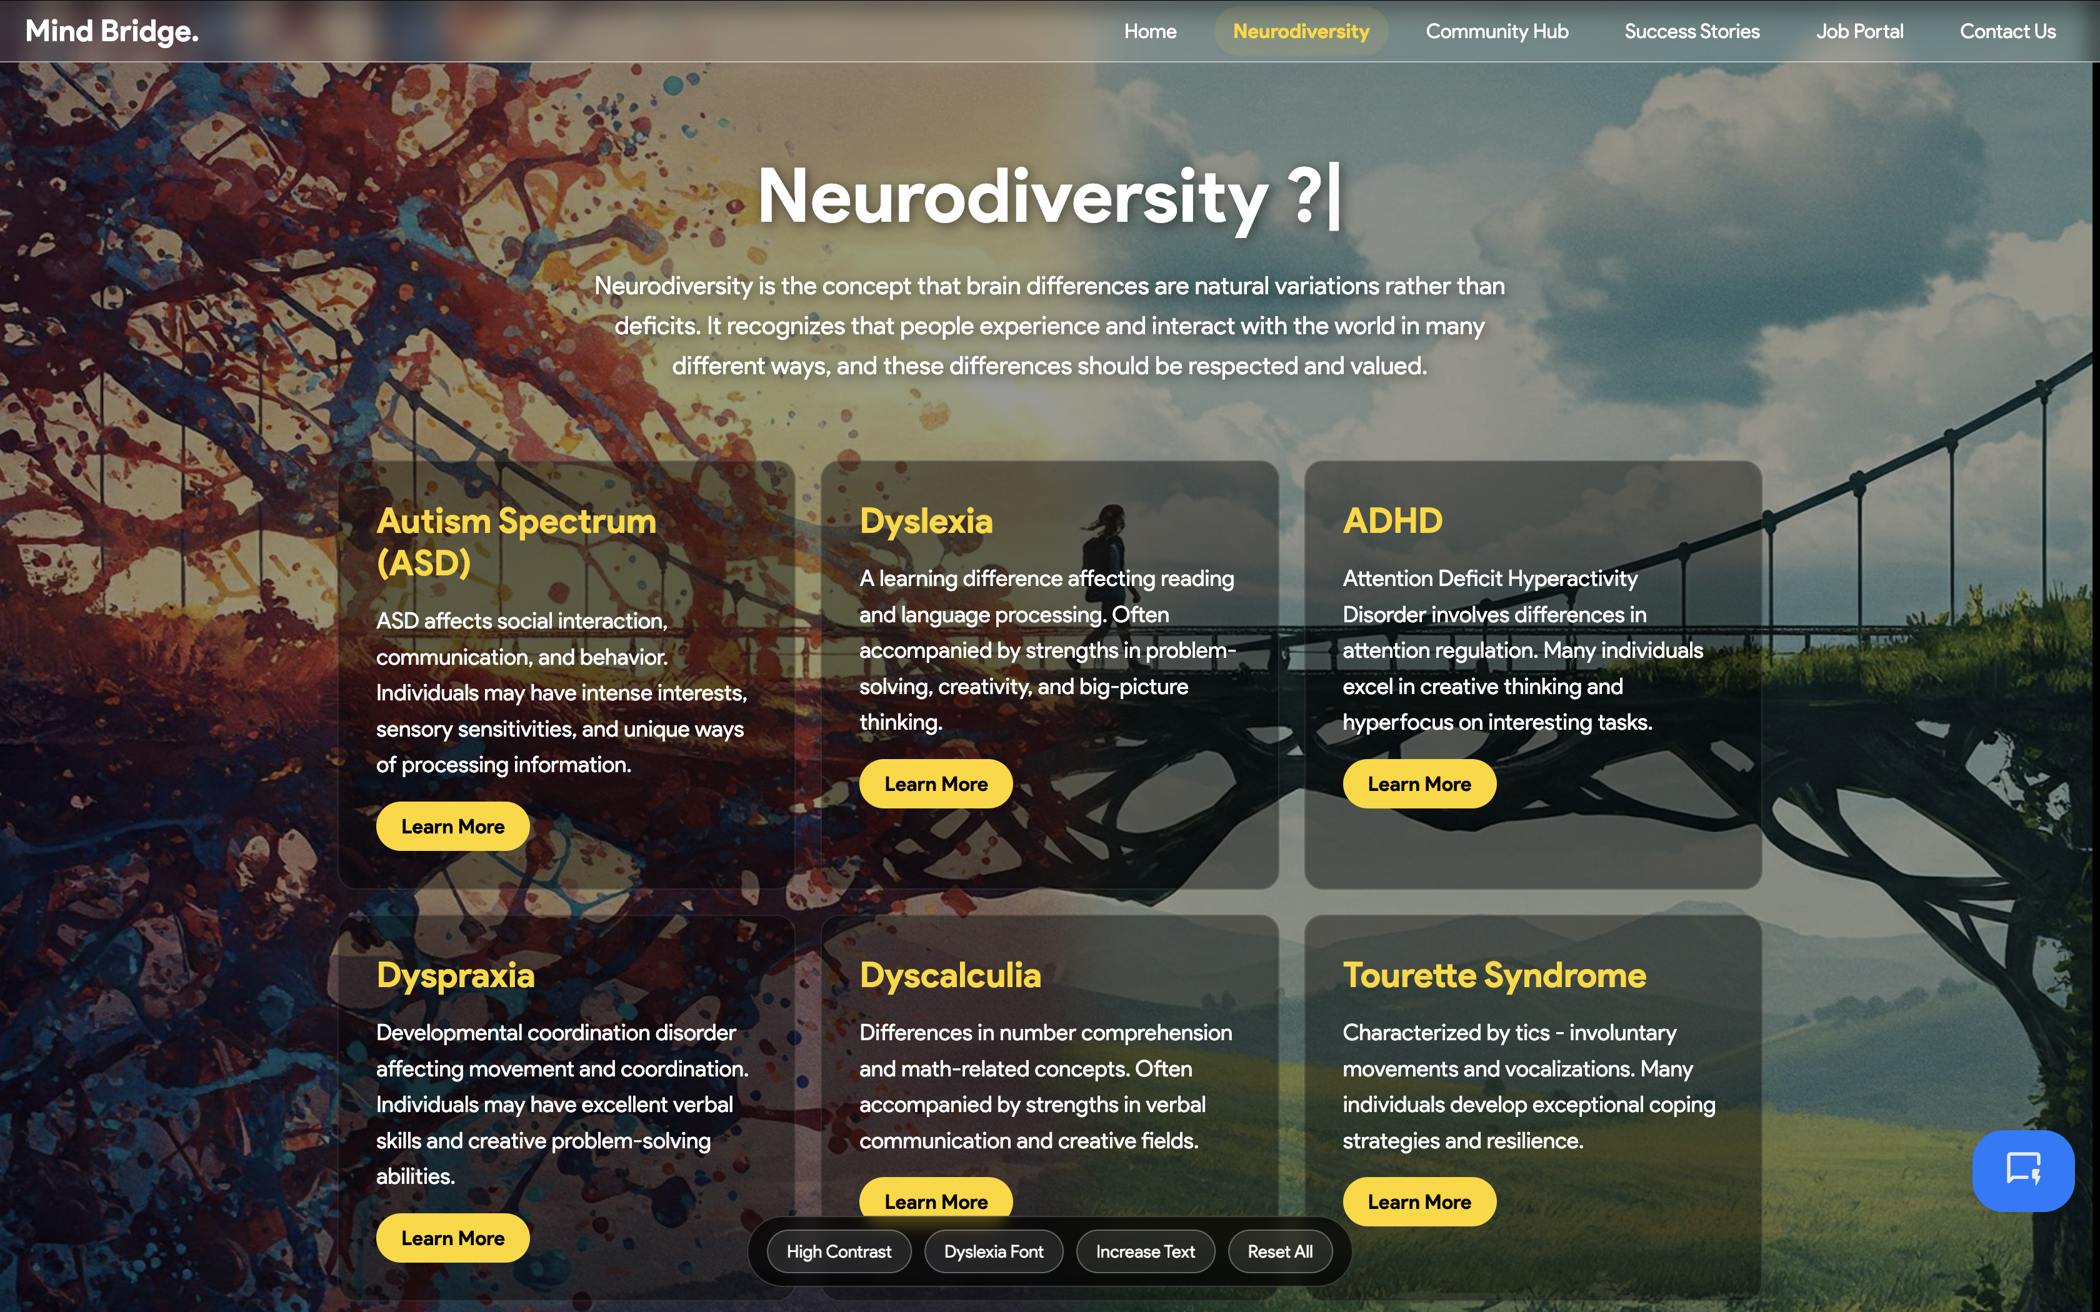
Explore Now Page

Slide 11
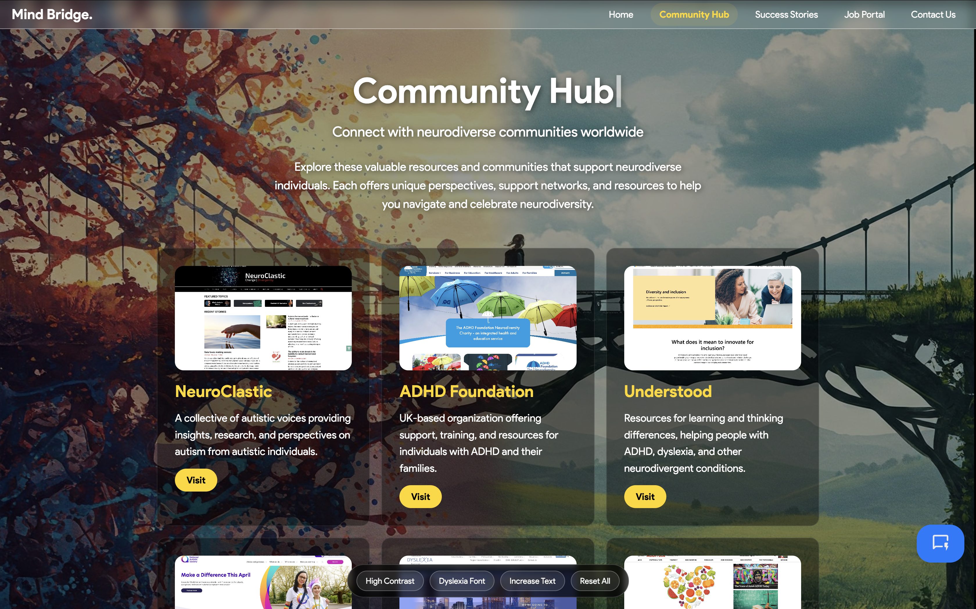
Community Hub

Slide 12
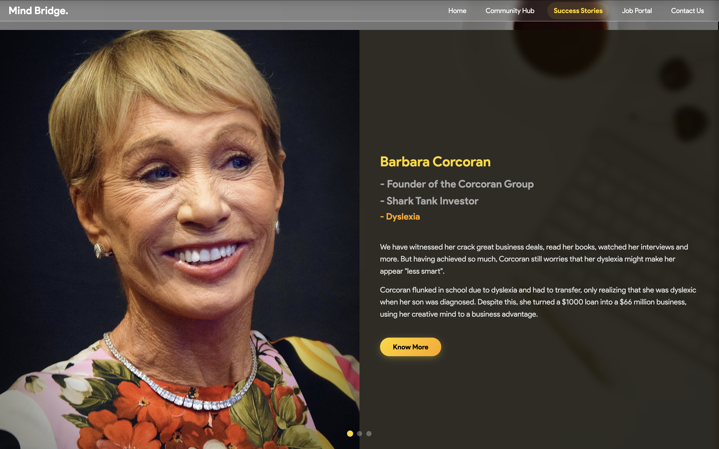
Success Stories

Slide 13
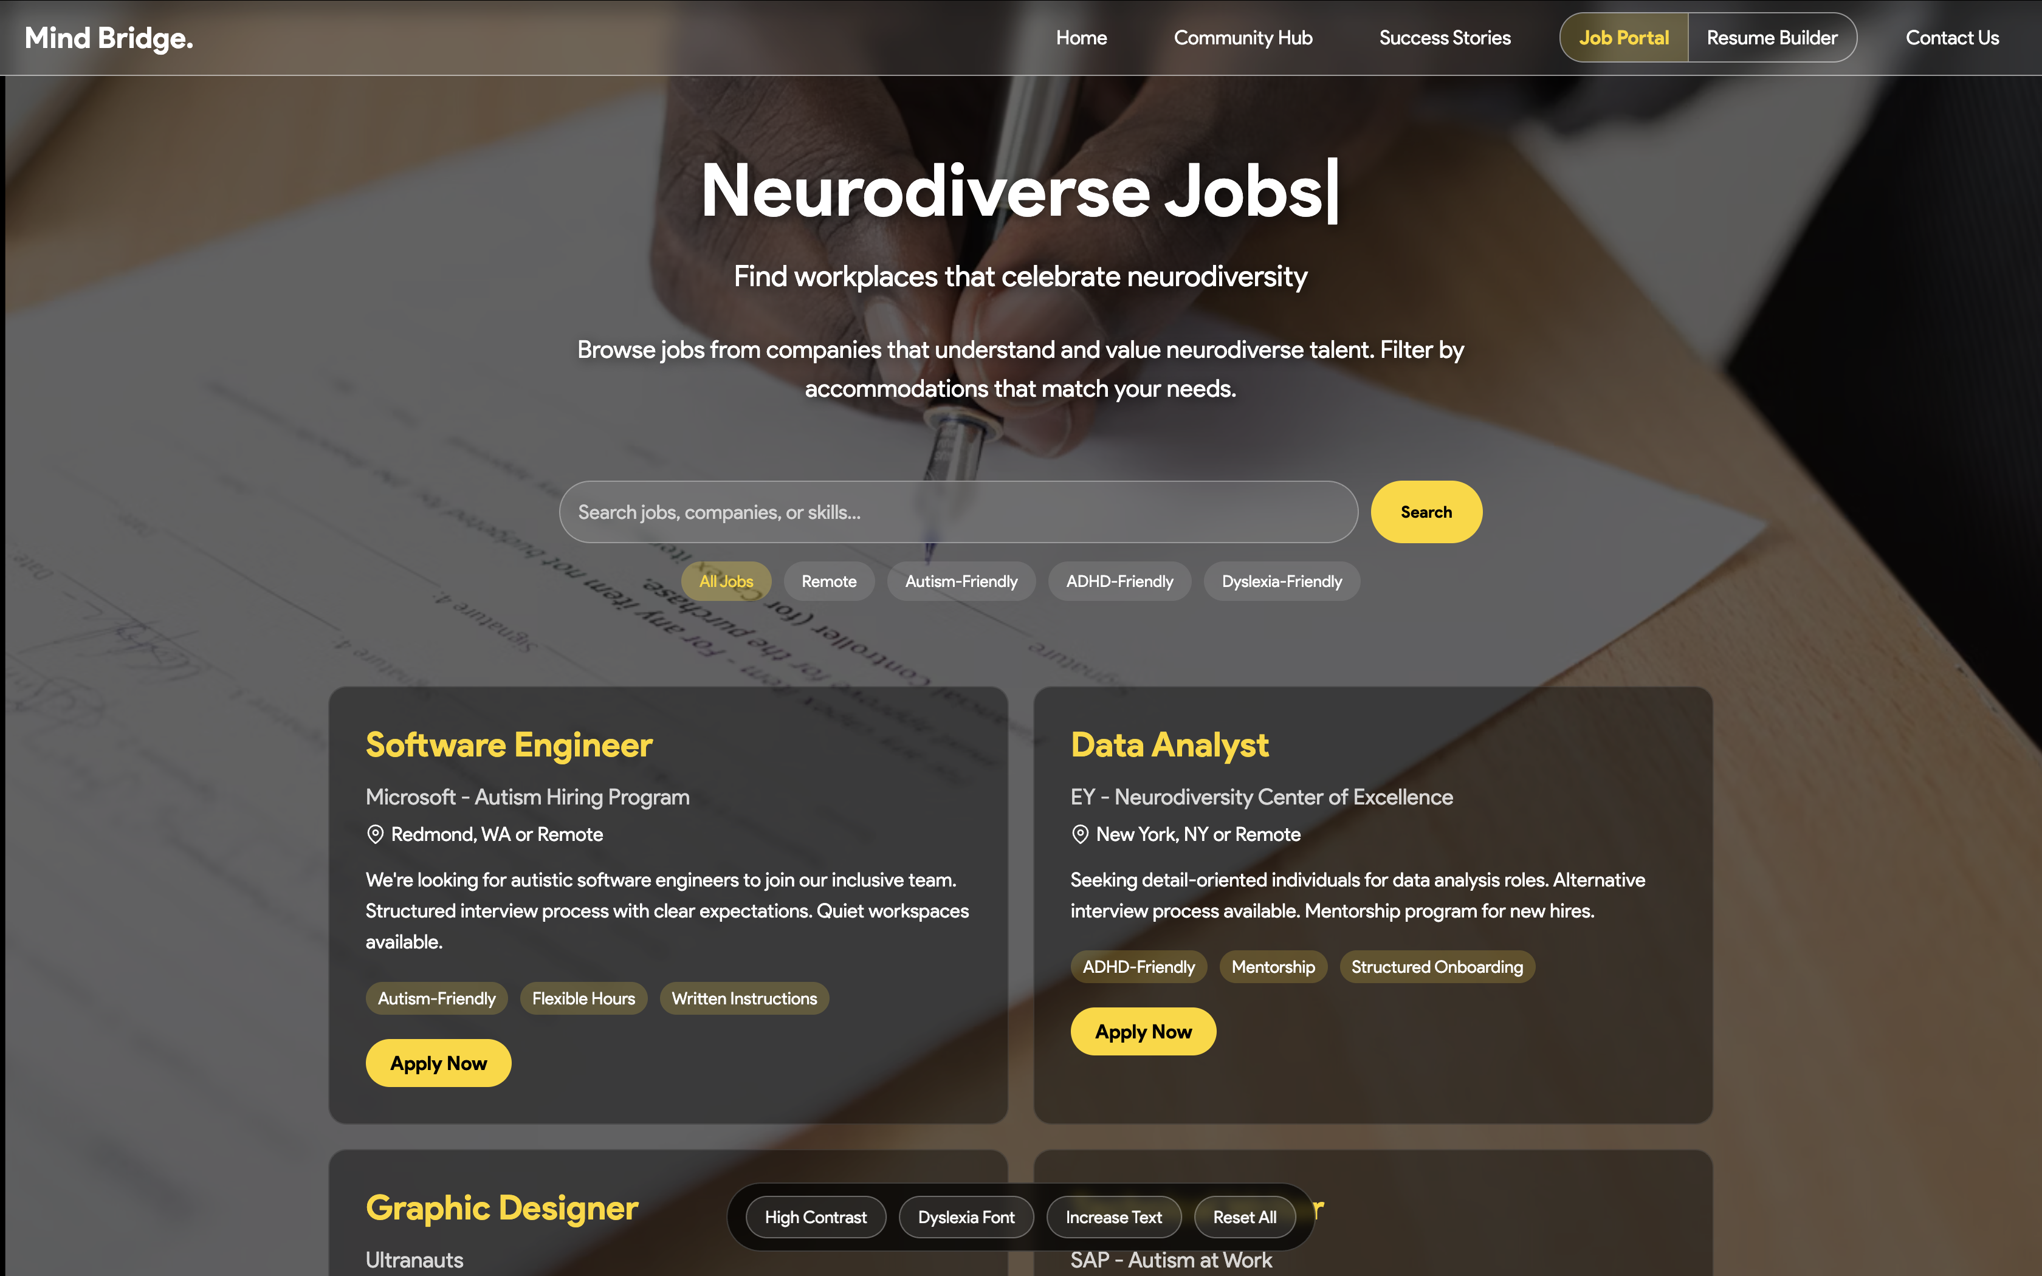
Job Portal

Slide 14
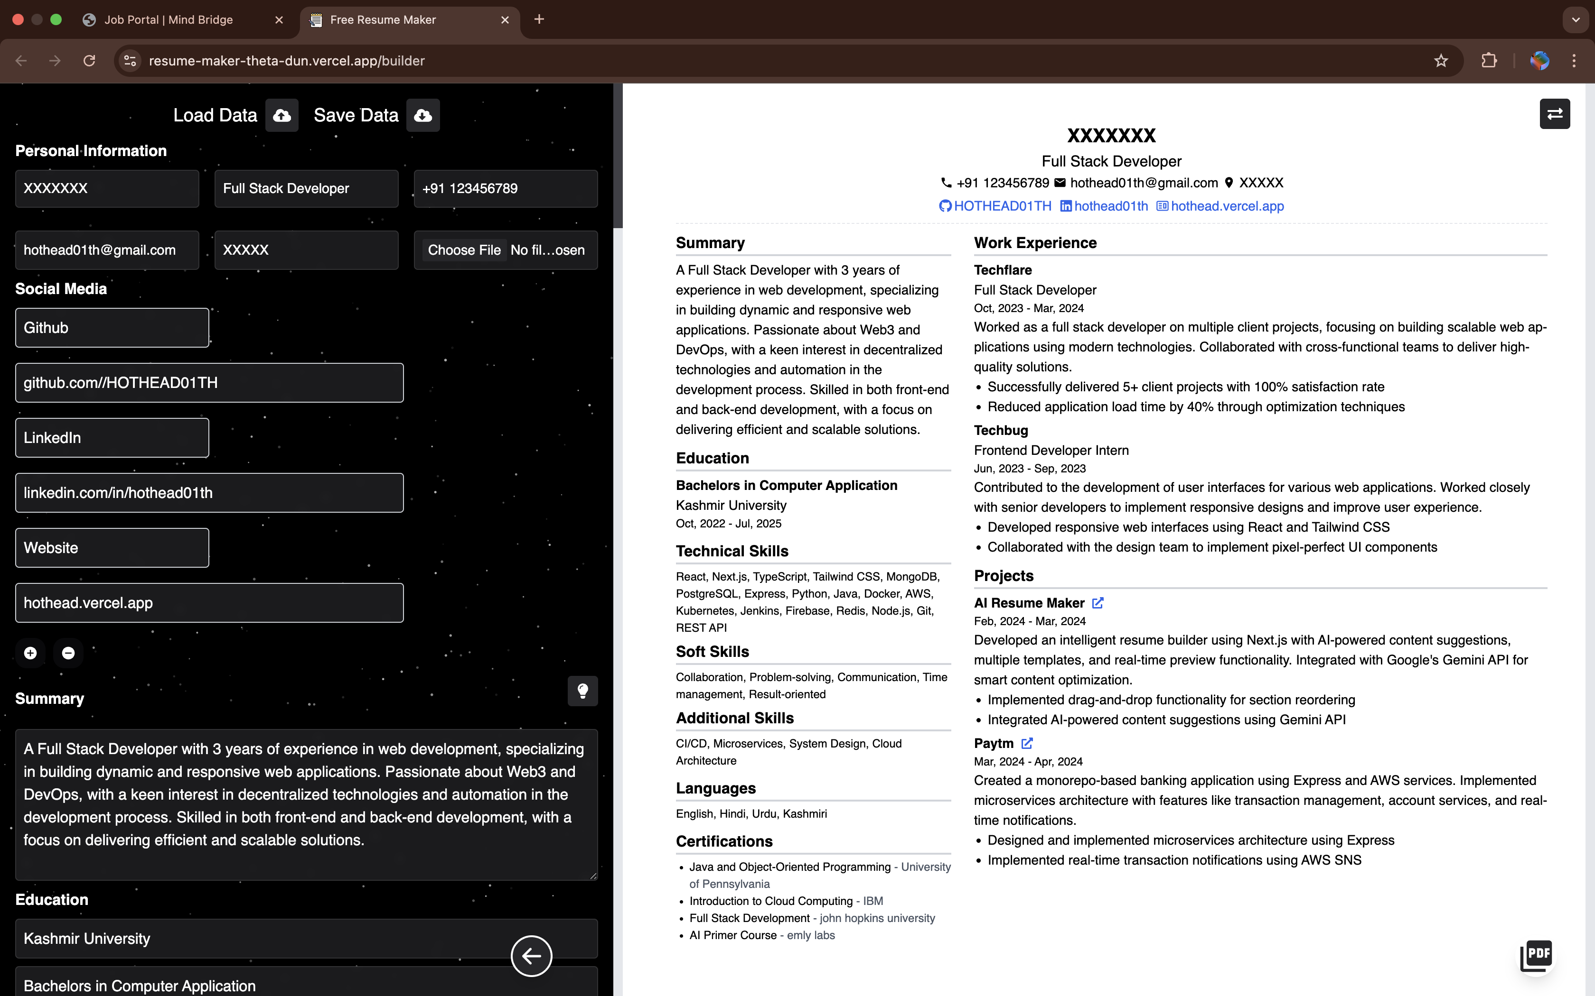
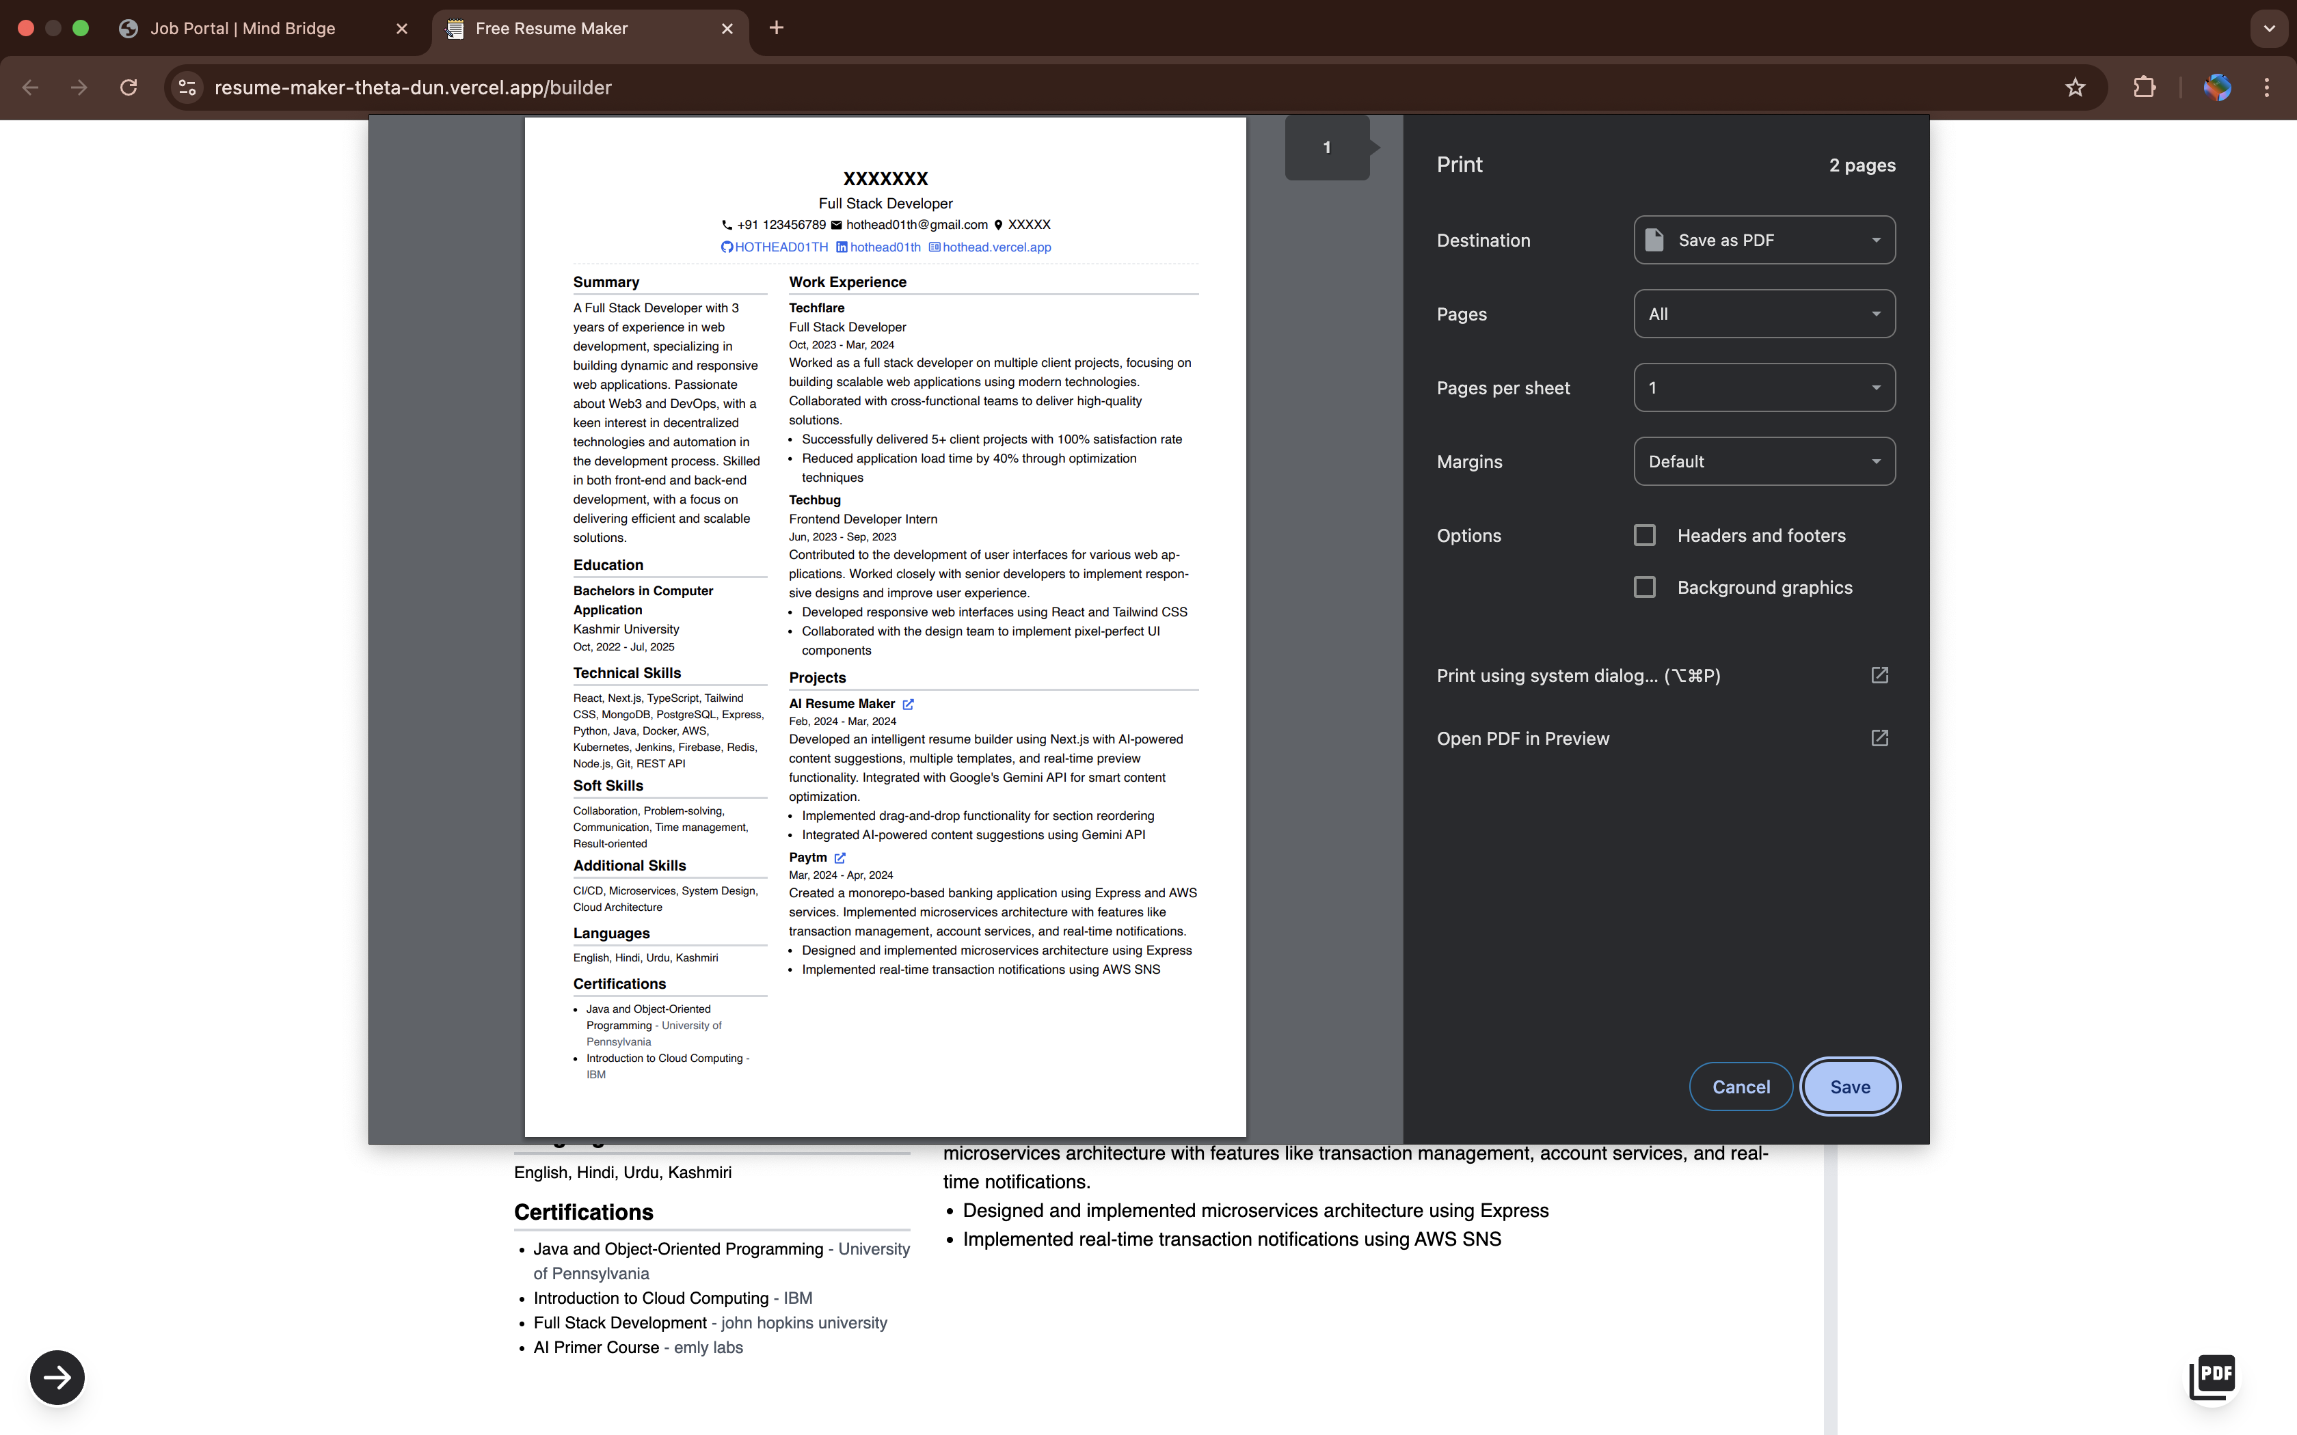
Resume Builder
Download It.
Edit your Resume

Slide 15
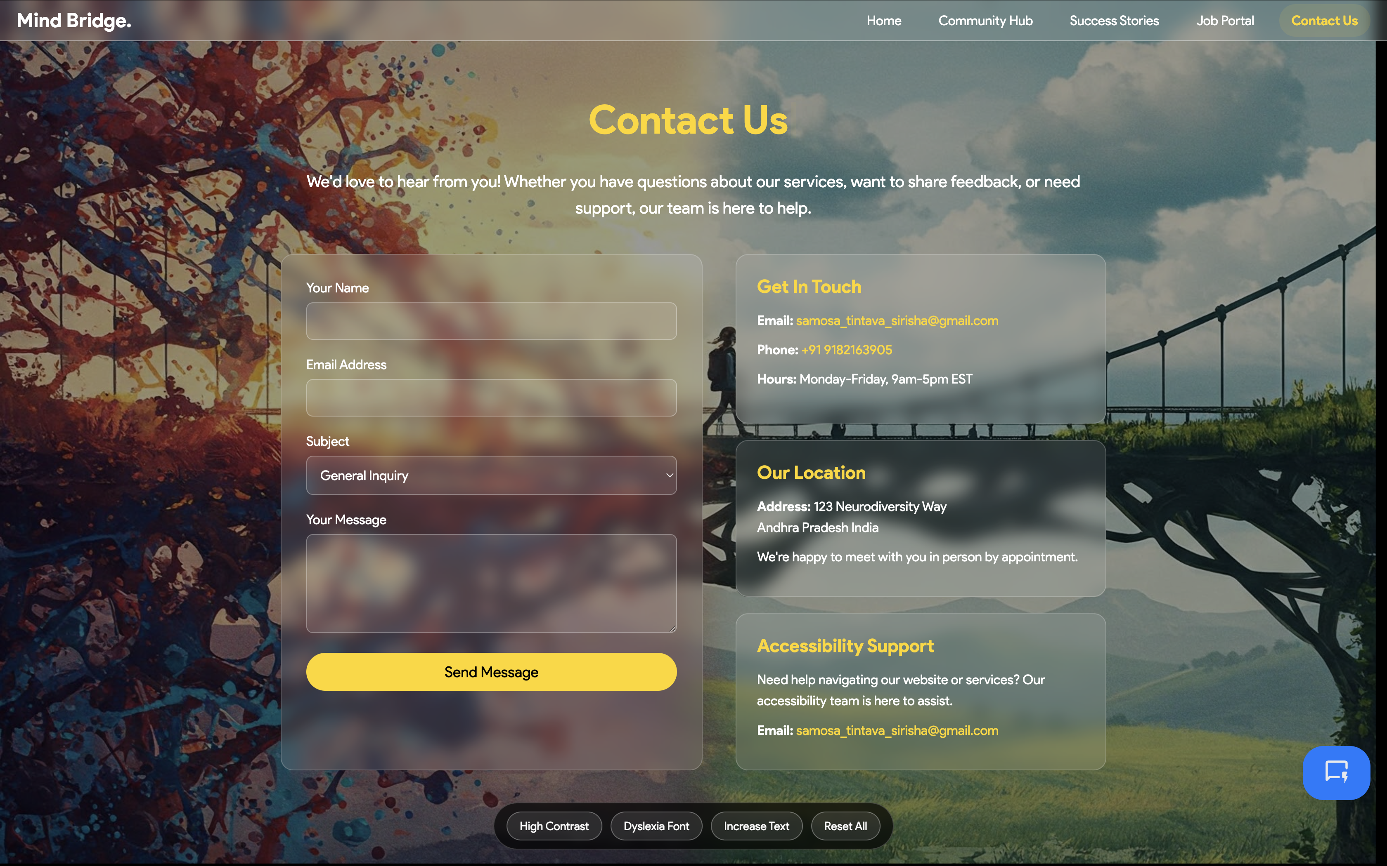
Contact Us

Slide 16
MindBridge.
Thank You…

